Slide 1
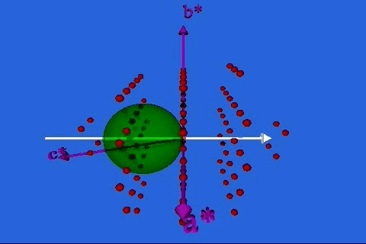
Ewald Sphere But do you have a detector in the right place to detect the peak?
http://www.doitpoms.ac.uk/tlplib/reciprocal_lattice/ewald.php
http://www.physics.byu.edu/faculty/campbell/animations/x-ray_diffraction.html

Slide 2
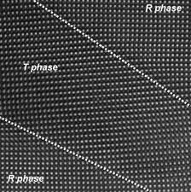
Reminder: Applications of XRD (X-ray diffraction)
XRD is a nondestructive and cheap technique. Some of the uses of x-ray diffraction are:
Determination of the structure and periodicity of crystalline materials
Determination of the orientation of single crystals
Differentiation between crystalline and amorphous materials, or if secondary phases
Measurement of (epitaxial) strain
Determination of electron distribution within the atoms, and throughout the unit cell (harder)
Measurement of layer thickness (related XRR)
Notes:
Before we get into what diffraction is, let’s discuss why you should care.
Secondary phases, compare to CaTiO3. Discuss valence. Can also form TiO2 and CaO. Also sometimes get different structures for the same atoms.
Thickness, either fringes if really thin and smooth or can do at low angle (x-ray reflectivity)

Slide 3
3 COMMON X-RAY DIFFRACTION METHODS
X-Ray Diffraction Method
Laue
Rotating Crystal
Powder

Slide 4
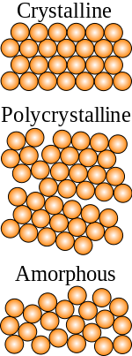
3 COMMON X-RAY DIFFRACTION METHODS
X-Ray Diffraction Method
Laue
Rotating Crystal
Powder
Lattice Parameters
Polycrystal/Powder
Monochromatic Beam
Fixed Angle

Slide 5
3 COMMON X-RAY DIFFRACTION METHODS
X-Ray Diffraction Method
Laue
Rotating Crystal
Powder
Lattice constant or Secondary Phases
Single Crystal
Monochromatic Beam
Variable Angle
Lattice Parameters
Polycrystal/Powder
Monochromatic Beam
Fixed Angle

Slide 6
3 COMMON X-RAY DIFFRACTION METHODS
X-Ray Diffraction Method
Laue
Rotating Crystal
Powder
Orientation
Single Crystal
Polychromatic Beam
Fixed Angle
Lattice constant or Secondary Phases
Single Crystal
Monochromatic Beam
Variable Angle
Lattice Parameters
Polycrystal/Powder
Monochromatic Beam
Fixed Angle

Slide 7
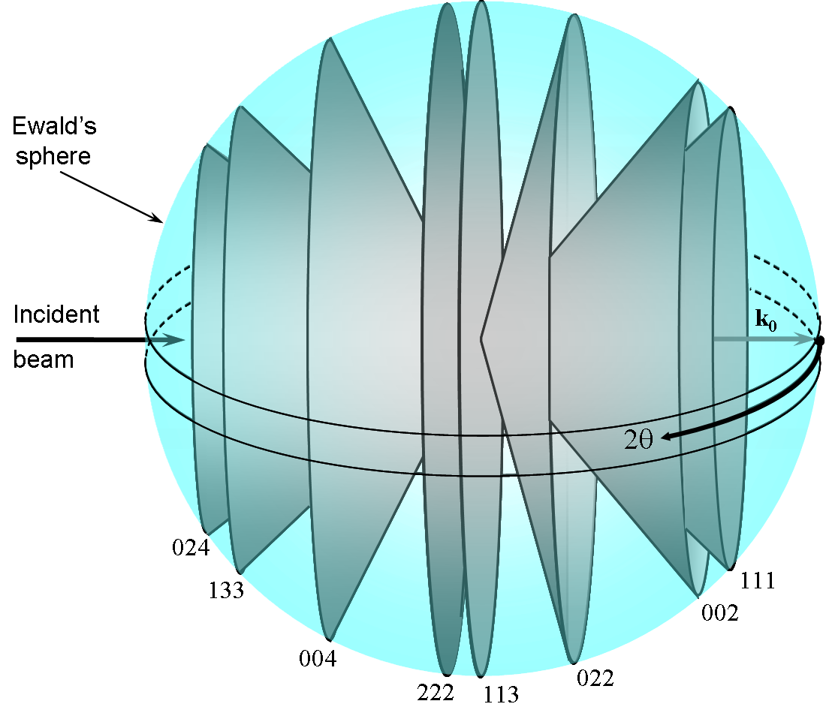
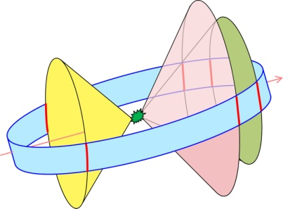
K

Slide 8
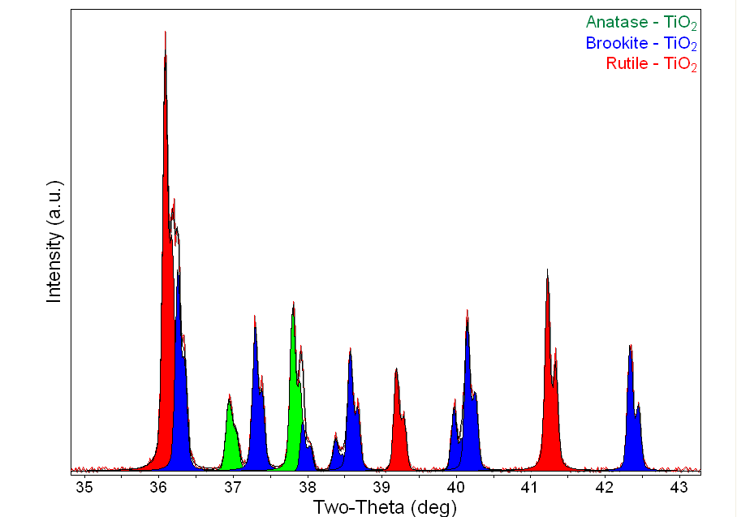
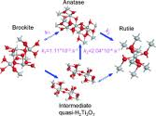
Useful for Phase Identification
The diffraction pattern for every phase is as unique as your fingerprint
Phases with the same element composition can have drastically different diffraction patterns.
Use the position and relative intensity of a series of peaks to match experimental data to the reference patterns in the database

Slide 9
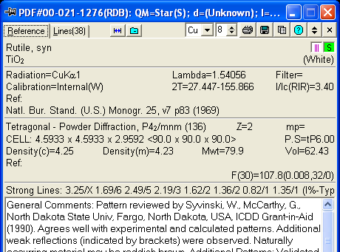
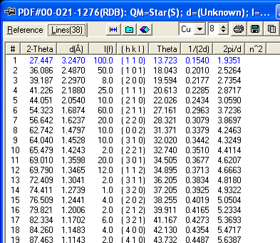
Databases such as the Powder Diffraction File (PDF) contain dI lists for thousands of crystalline phases.
The PDF contains over 200,000 diffraction patterns.
Modern computer programs can help you determine what phases are present in your sample by quickly comparing your diffraction data to all of the patterns in the database.

Slide 10
Quantitative Phase Analysis
With high quality data, you can determine how much of each phase is present
The ratio of peak intensities varies linearly as a function of weight fractions for any two phases in a mixture
RIR method is fast and gives semi-quantitative results
Whole pattern fitting/Rietveld refinement is a more accurate but more complicated analysis
Reference Intensity Ratio Method
Notes:
RIR method: need to know the constant of proportionality

Slide 11
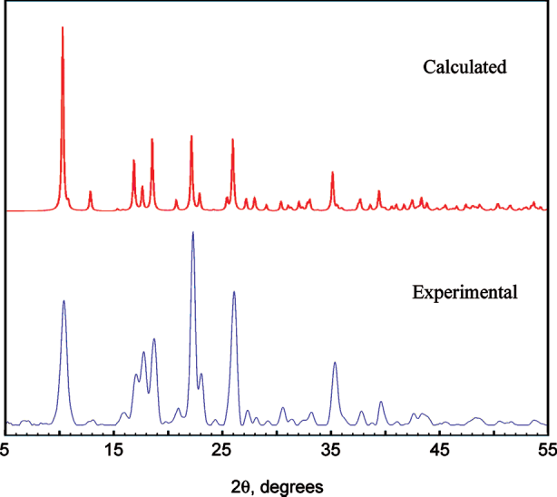
Applications of Powder Diffractometry
phase analysis (comparison to known patterns)
unit cell determination (d_{hkl}′s depend on lattice parameters)
particle size estimation (line width)
crystal structure determination (line intensities and profiles)

Slide 12
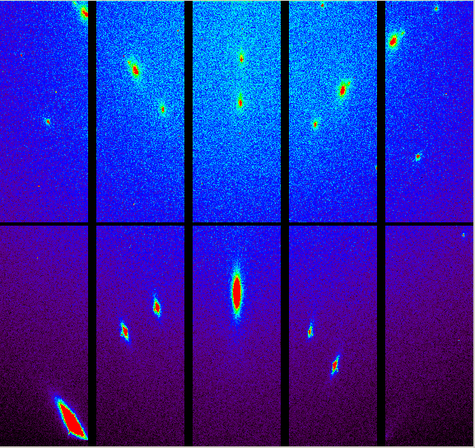
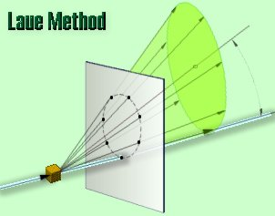
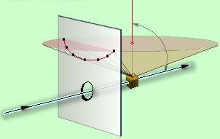
Back-reflection vs. Transmission Laue Methods
In the back-reflection method, the film is placed between the x-ray source and the crystal. The beams which are diffracted backward are recorded.
Which is this?
X-rays have wide wavelength range (called white beam).
Single
Crystal
X-Ray
Film
Single
Crystal
Film
X-Ray
The diffraction spots generally lay on:
an ellipse
a hyperbola

Slide 13
LAUE METHOD
The diffracted beams form arrays of spots, that lie on curves on the film.
The symmetry of the pattern reflects the symmetry of the crystal when viewed along the direction of the incident beam.
Each set of planes in the crystal picks out and diffracts a particular wavelength from the white radiation that satisfies the Bragg law for the values of d and θ involved.
Notes:
Laue on one of our thin films.

Slide 14
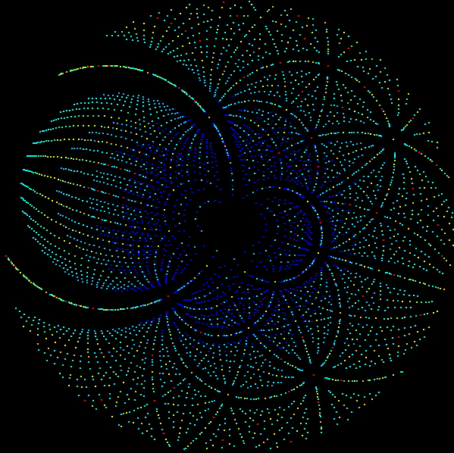
Crystal structure determination by Laue method?
Although the Laue method can be used, several wavelengths can reflect in different orders from the same set of planes, making structure determination difficult (use when structure known for orientation or strain).
Rotating crystal method overcomes this problem. How?
Notes:
You would interpret from the intensity of the spots, but if multiple spots are at the same location, that’s a problem.
Materials scientists typically already know the crystal structure for a material they’ve worked on a lot and then this method can be used to understand orientation or strain tensors.

Slide 15
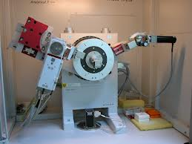
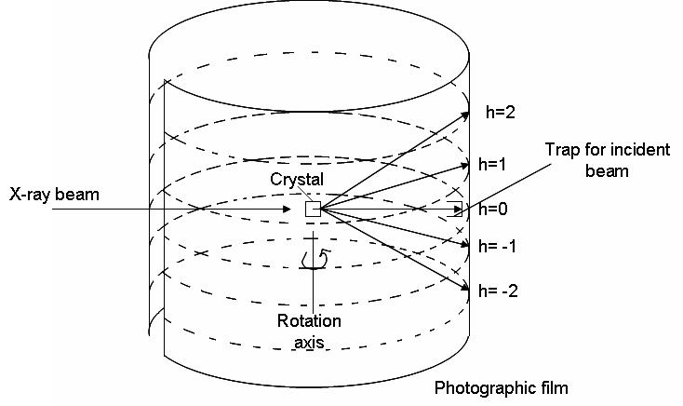
ROTATING CRYSTAL METHOD
A single crystal is mounted with a rotation axis perpendicular to a monochromatic x-ray beam.
A cylindrical film is placed around it and the crystal is rotated. Or a detector is rotated.
Sets of lattice planes will at some point make the correct Bragg angle, and at that point a diffracted beam will be formed.

Slide 16
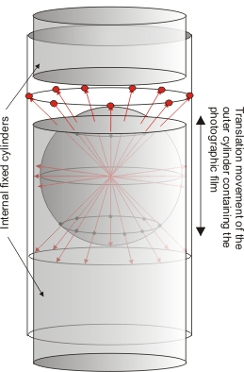
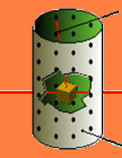
Rotating Crystal Method
Reflected beams are located on imaginary cones.
By recording the diffraction patterns (both angles and intensities), one can determine the shape and size of unit cell as well as arrangement of atoms inside the cell.
But around what axis should you rotate?
Film
Notes:
Requires various orientations measured and you may not know where those orientations are, so hard if that is the case.
You might get lucky if you guess or you could…

Slide 17
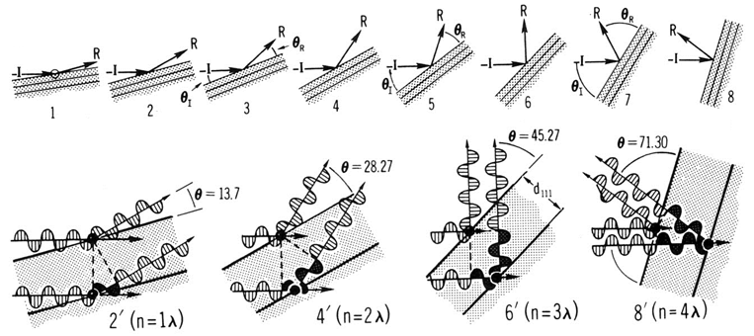
Bragg Equation:
The diffracted beams (reflections) from any set of lattice planes can only occur at particular angles predicted by the Bragg law.
Bragg-Brentano diffractometer (θ_{in}=θ_{out})
Above are 1st, 2nd, 3rd and 4th order “reflections” from the (111) face of NaCl. Orders of reflections are given as 111, 222, 333, 444, etc. (without parentheses!)
Notes:
When atoms are specific phases apart. Otherwise they destructively interfere over the many layers of the crystal. Also shows why higher order diffraction occurs (just off by a multiple of the wavelength).
Note: While peaks should not technically be labeled with parentheses, it is very common to see them labelled that way. Likely even my examples will sometimes show them that way.

Slide 18
A single crystal specimen in a Bragg-Brentano diffractometer (θ_{in}=θ_{out}) would produce only one family of peaks in the diffraction pattern.
Why might you use this technique?
2θ
The (110) planes would diffract at 29.3 °2θ; however, the detector is not at that position (the perpendicular to those planes does not bisect the incident and diffracted beams). Only background is observed.
At 20.6° (2θ), Bragg’s law fulfilled for the (100) planes, producing a diffraction peak.
The (200) planes are parallel to the (100) planes. Therefore, they also diffract for this crystal. Since d₂₀₀ is ½ d₁₀₀, they appear at 42° (2θ).
Notes:
Good for determining lattice parameters. It’s also simple. It’s not too hard to figure out what all of your peaks are.

Slide 19
The X-ray Shutter is the most important safety device on a diffractometer
X-rays exit the tube through X-ray transparent Be windows.
X-Ray safety shutters contain the beam so that you may work in the diffractometer without being exposed to the X-rays.
Being aware of the status of the shutters is the most important factor in working safely with X rays.

Slide 20
XRD: “Rocking” Curve Scan
G
G
Sample normal
“Rock” Sample
Vary ORIENTATION of G relative to sample normal while maintaining its magnitude. How? “Rock” sample over a very small angular range.
Resulting data of Intensity vs. Omega (ω, sample angle) shows detailed structure of diffraction peak being investigated. Can inform about quality of sample.
Notes:
Draw a flat line versus a line with small tilts in either direction

Slide 21
XRD: Rocking Curve Example
GaN Thin Film
(002) Reflection
How do you know if this is good?
Compare to literature to see how good (some materials naturally easier than others)
16000
Intensity (Counts/s)
8000
Generally limited by quality of substrate
0
16.995
17.195
17.395
17.595
17.795
Omega (deg)
Rocking curve of single crystal GaN around (002) diffraction peak showing its detailed structure.
Notes:
Could give a whole course on diffraction, but lots more to cover
I’m not talking politics, I just think having Obama cropped in the picture is funny.

Slide 22
X-ray reflectivity (XRR) measurement
A glancing, but varying, incident angle, combined with a matching detector angle collects the X rays reflected from the samples surface
Calculation of the density, composition, thickness and interface roughness for each particular layer
ρ t [Å] σ [Å]
0.68 19.6 5.8
0.93 236.5 34.0
1.09 14.1 2.7
1.00 5.0 2.7
1.00 2.8
Edge of TER
Mo
Mo
Kiessig oscillations (fringes)
Mo
W
Si
The surface must be smooth (mirror-like)

Slide 23
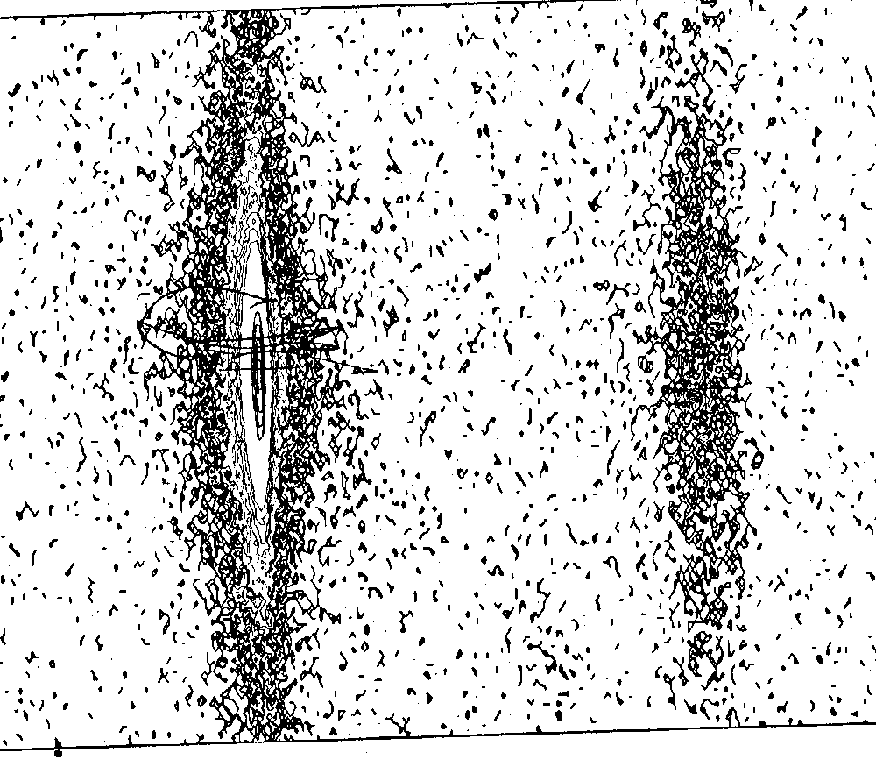
XRD: Reciprocal-Space Map
GaN(002)
AlN
ω
ω/2Θ
Vary Orientation and Magnitude of Δk (G).
Diffraction-Space map of GaN film on AlN buffer shows peaks of each film.

Slide 24
Non-xray Diffraction Methods (more in later chapters)
Any particle will scatter and create diffraction pattern
Beams are selected by experimentalists depending on sensitivity
X-rays not sensitive to low Z elements, but neutrons are
Electrons sensitive to surface structure if energy is low
Atoms (e.g., helium) sensitive to surface only
For inelastic scattering, momentum conservation is important
X-Ray
Neutron
Electron
λ = 1A°
E ~ 10⁴ eV
interact with electron
Penetrating
λ = 1A°
E ~ 0.08 eV
interact with nuclei
Highly Penetrating
λ = 2A°
E ~ 150 eV
interact with electron
Less Penetrating
Notes:
Replace top figure (not so informative, probably more confusing)

Slide 25
Extra slides
There is a lot of useful information on diffraction. Following are some related slides that I have used or considered using in the past.
A whole course could be taught focusing on diffraction so I can’t cover everything here.

Slide 26
Group: Consider Neutron Diffraction
Qualitatively discuss the atomic scattering factor (e.g., as a function of scattering angle) for neutron diffraction (compared to x-ray) by a crystalline solid.
For x-rays, we saw that f is related to Z and has a strong angular component. For neutrons?
The same equation applies, but since the neutron scatters off a tiny nucleus, scattering is more point-like, and f is ~ independent of θ.
Notes:
3.9

Slide 27
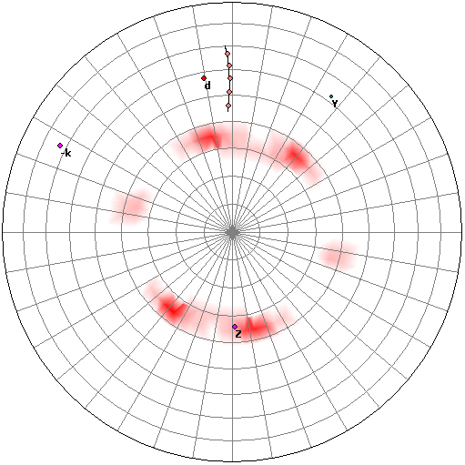
Preferred Orientation (texture)
Diffracting crystallites
Preferred orientation of crystallites can create a systematic variation in diffraction peak intensities
can qualitatively analyze using a 1D diffraction pattern
a pole figure maps the intensity of a single peak as a function of tilt and rotation of the sample
this can be used to quantify the texture
10.0
(111)
00-004-0784> Gold - Au
8.0
(311)
6.0
(200)
Intensity(Counts)
(220)
4.0
2.0
(222)
(400)
x10
3
40
50
60
70
80
90
100
Two-Theta (deg)

Slide 28
3 COMMON X-RAY DIFFRACTION METHODS
X-Ray Diffraction Method
Laue
Rotating Crystal
Powder
Orientation
Single Crystal
Polychromatic Beam
Fixed Angle
Lattice constant or Secondary Phases
Single Crystal
Monochromatic Beam
Variable Angle
Lattice Parameters
Polycrystal/Powder
Monochromatic Beam
Fixed Angle

